Slide 1
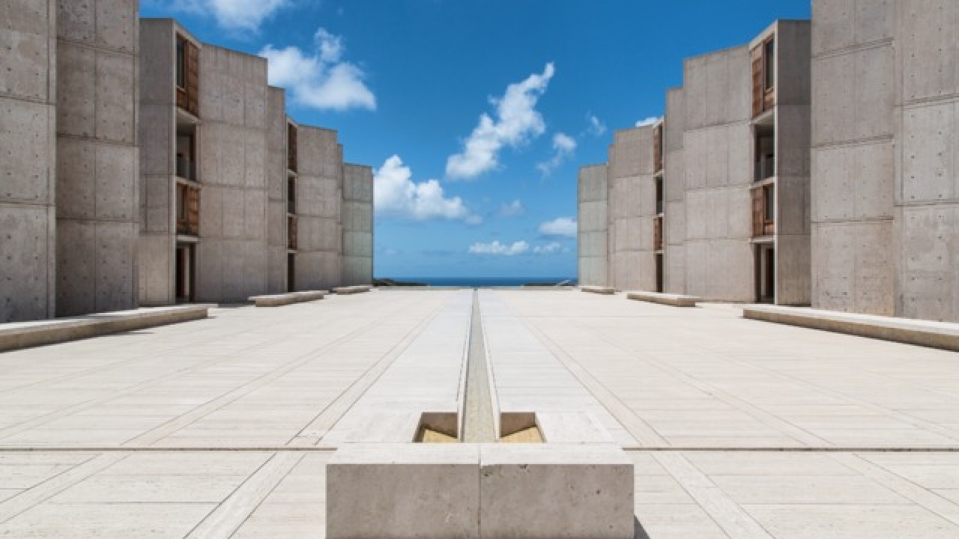
Towards Biophysically-Based Neuromorphic Computing at Scale: Markov Abstractions of Electrochemical Reaction-Diffusion in Synaptic Transmission
Margot Wagner University of California, San Diego; Salk Institute
Notes:
Hello everyone.
My name is Margot Wagner, and I am a third year PhD student being co-advised by Terry Sejnovski here at Salk in the Computational Neurobiology Lab and Gert Cauwenberghs at UCSD in Bioengineering
Today I am going to talk to you about Biophysically-Based Abstractions of Synaptic Transmission for Use in Neuromorphic Systems

Slide 2
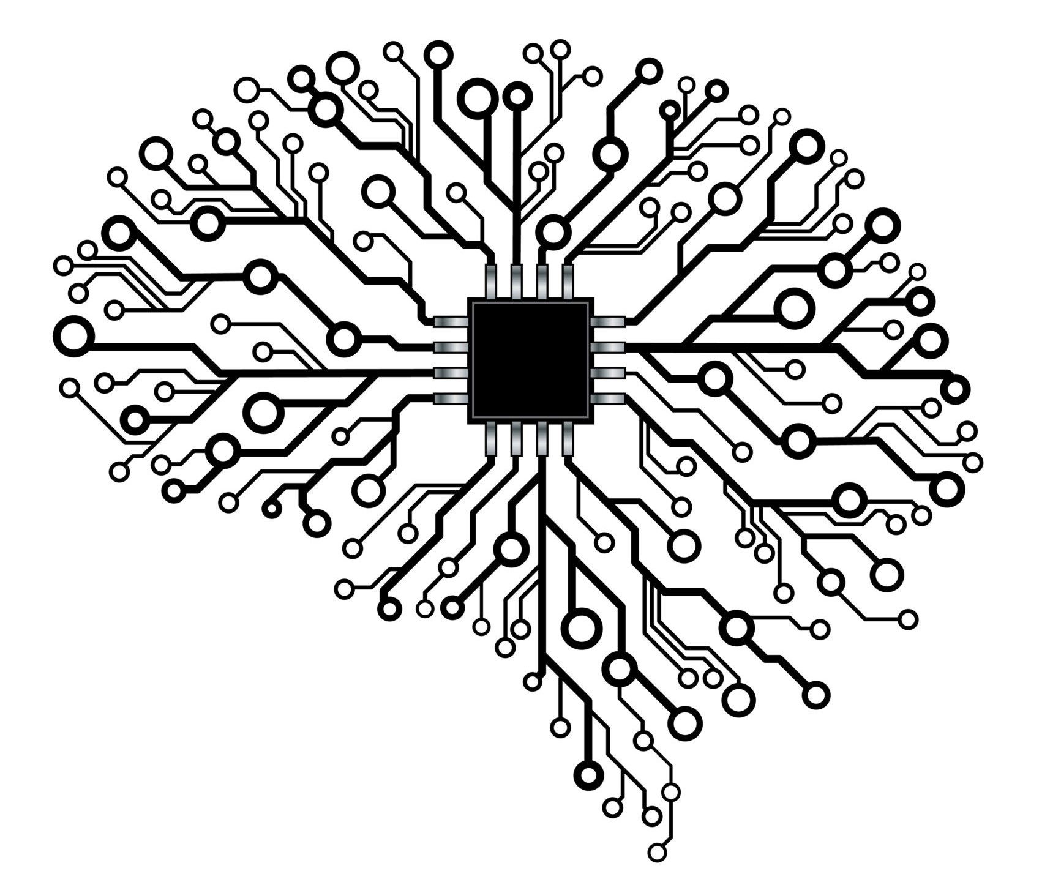
Background
Neuromorphic: biologically inspired hardware
- The tradeoff: biological realism vs computational complexity
- The synapse forms connections which are the basis of learning and memory in both biological and artificial neural networks
- What are we missing out on by simplifying the synapse?
Notes:
Neuromorphic hardware looks to implement neural networks in chips, so it is biologically-inspired by desin
But there is a tradeoff between biological realism and computational complexity where systems are built with simpler integrate and fire type models for example to allow for scalability
Of particular importance in these models is the synapse which forms connections between neurons and is the basis of learning and memory in both biological neural networks and these artificial networks
With current models in neuromorphic systems, we are losing out on a lot of the complexity and higher order dynamics of synapses, which begs the question, what are we losing by making these assumptions?

Slide 3



The Goal
Implement a detailed biophysically realistic model of synaptic behavior in the brain using reaction-diffusion in a spatially realistic 3D geometry.
Abstract simulation details to create a computationally efficient software model for scalability while maintaining a biophysically tunable model.
Implement biophysically tunable model into a neuromorphic hardware system.
Notes:
Our goal is to take biophysically realistic models validated experimentally and abstract them into biological yet computationally efficient models that are readily scalable for implementation into these neuromorphic systems

Slide 4
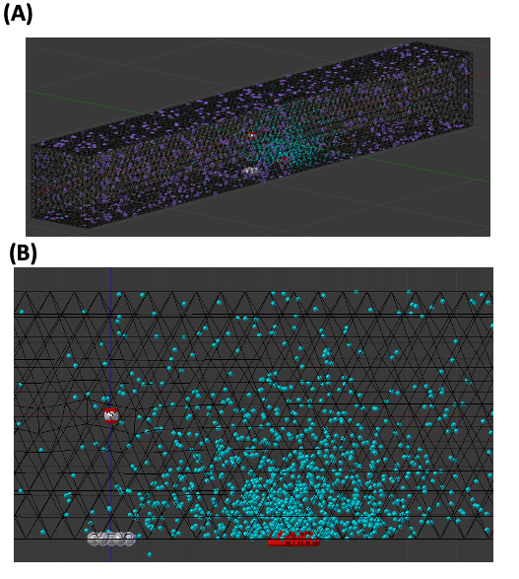
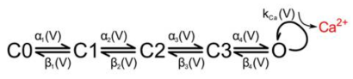
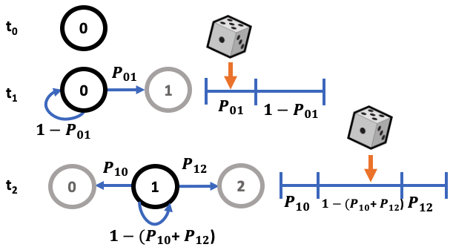
Methods
Voltage-dependent calcium channels in response to stimulus, calcium influx, and calcium buffer binding to predict neurotransmitter release.
Efficient multinomial Markov Chain Monte Carlo implementation
Notes:
We did this by first building a complete biological model using Mcell’s realistic 3D geometric stochastic reaction-diffusion framework.
This model included all the necessary components for presynaptic transmission from the stimulus input to the calcium influx presynaptically and eventual neurotransmitter release
Equivalently we modelled these kinetics as Markov chains where the molecules exist in a state at any given time and the next state can be predicted from the current state using random sampling of the transition probabilities.
We can make this even more efficient by implementing it with multinomial sampling to look at the number of molecules or channels in each state at a certain time rather than individually tracking each molecule

Slide 5
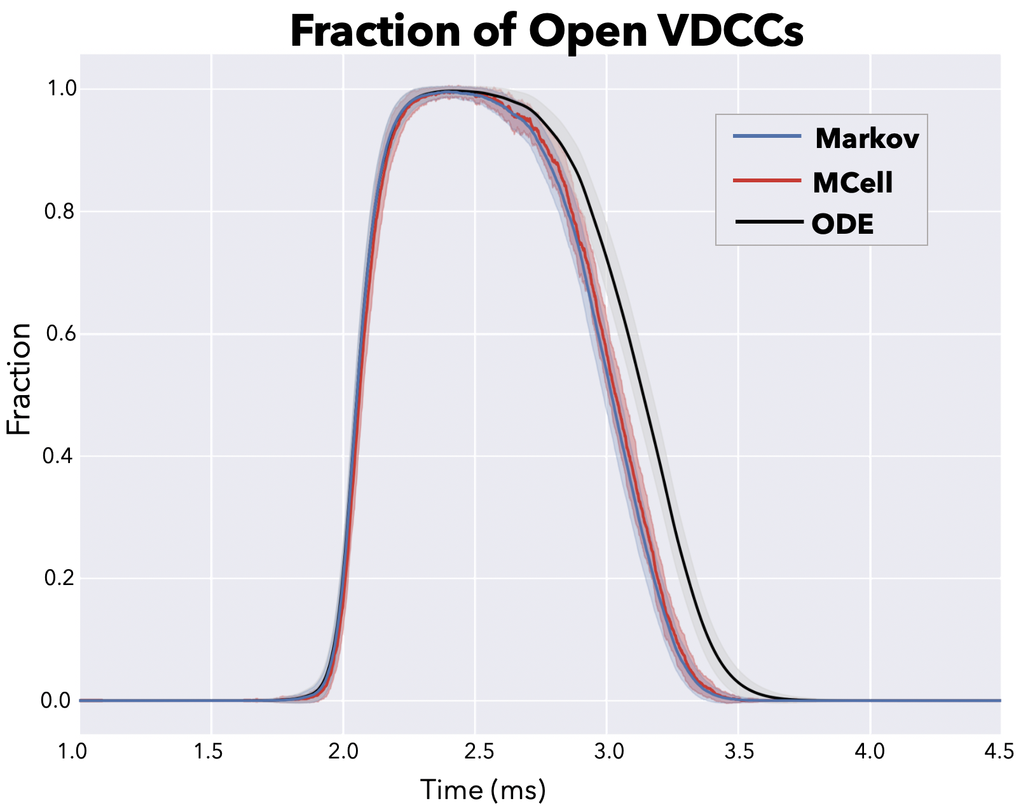
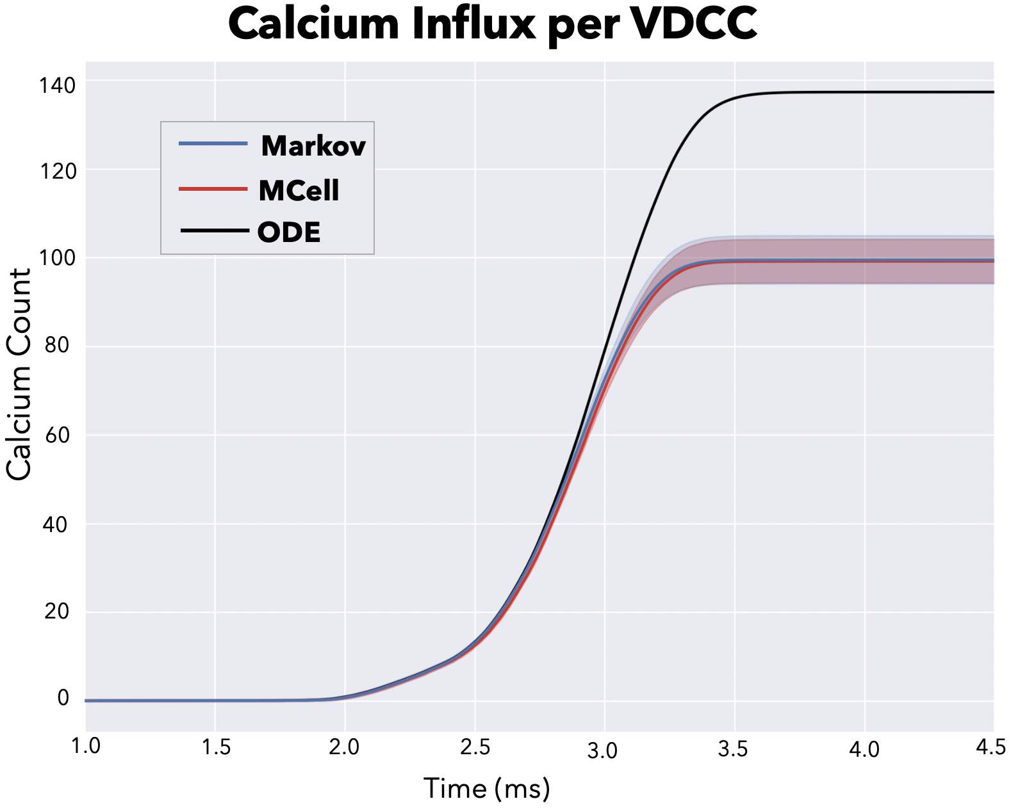
Results
Notes:
We find that this multinmial markov abstraction does a really good job of replicating the Mcell simulations.
Here we show some example transient looking at the number of open voltage-dependent calcium channels as well as the calcium influx per channel over time

Slide 6
Benchmarks
VDCC | Runtime | Floating Point Operations
MCell | 139.20 ± 7.0 s | --
Standard Markov | 109.16 ± 0.93 s | 7.01 (± .02)E+07
Multinomial Markov | 9.40 ± 0.08 s | 1.26(± .01)E+07
ODE (Euler)* | 10.05 ± 0.13 s | 7.73E+06
Calbindin | Runtime | Floating Point Operations
MCell | 29.34 ± 0.39s | --
Standard Markov | 4.10E+4 s | 4.612 (± .002) E+07
Multinomial Markov | 2.37 ± .02 s | 2.72E+07 (± 8E+03)
ODE (Euler)* | 0.72 ± 0.01 s | 1.60E+06
* accuracy loss with deterministic solution
Notes:
We see an incredible increase in efficiency for runtime and number of operations between the MCell method, a classical markov implementation, and our optimized multinomial markov model
This makes us hopeful for the future to be able to implement these biological models at large scale in neuromorphic systems.

Slide 7


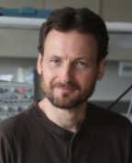
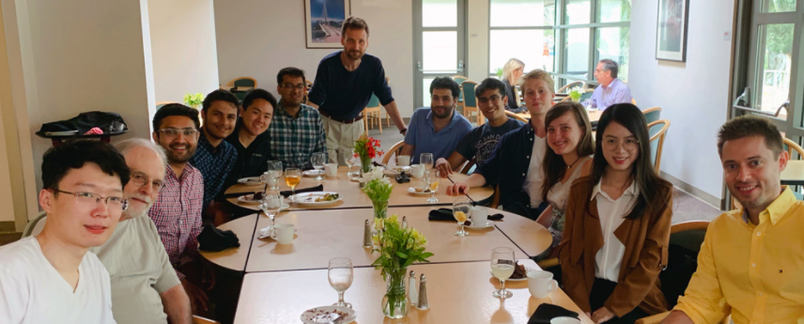


Acknowledgements
CNL Lab
Special thanks to Terry Sejnowski and Tom Bartol
ISN Lab
Special thanks to Gert Cauwenberghs
Funding
National Science Foundation
Salk institute
Notes:
Thank everyone
We have a paper preprint up on bioarchive with the same title if you’d like to read more, I highly recommend you look for that

